Slide 1
Control Flow
Sabrina Tarin Chowdhury

Slide 2
Control Flow
Basic paradigms for control flow:
Sequencing
Selection
Iteration
Procedural Abstraction
Recursion
Concurrency
Exception Handling and Speculation
Nondeterminacy

Slide 3
Focus:
Basic paradigms for control flow:
Sequencing: order of execution
Selection (also alternation): generally in the form of if or case statements
Iteration: loops
Recursion: expression is defined in terms of (simpler versions of) itself
Nondeterminacy: order or choice is deliberately left unspecified

Slide 4
Expression Evaluation
Precedence, associativity (see Figure on next slide)
C has 15 levels - too many to remember
Pascal has 3 levels - too few for good semantics
Fortran has 8
Ada has 6
Ada puts and & or at same level
Lesson: when unsure, use parentheses!

Slide 5
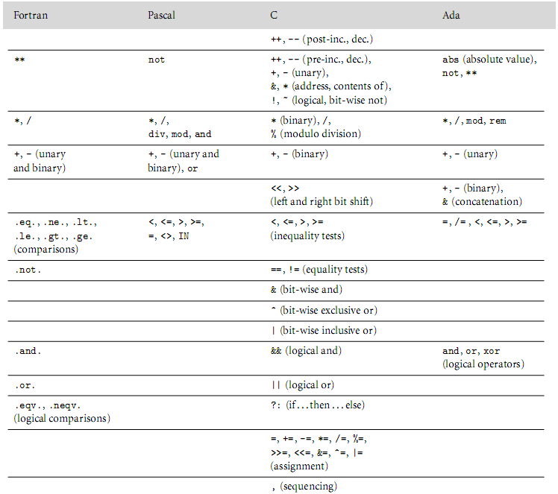
Expression Evaluation
Operator precedence levels in Fortran, Pascal, C, and Ada. The operator s at the top of the ﬁgure group most tightly.

Slide 6
Operator Associativity.
Operator associativity is the property that determines the order the operations when operators have the same precedence
Usually left to right
But some operators often are right-associative:
Exponentiation: 2^3^4 (3^4 done first)
Assignment: x = y = z (y = z done first)

Slide 7
Operator Overloading
Operator overloading is having multiple definitions of an operator
+ can be overloaded to handle types that aren’t usually added, like objects
In C++, & can mean:
The address of a variable
Bitwise AND
Can be confusing to read a program with overloaded operators

Slide 8
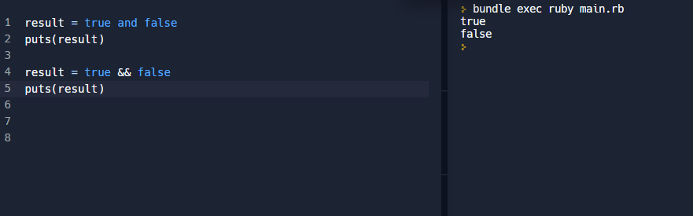
17. In Ruby, you can use && and and to mean "and" and || and or to mean or. But, they do not all have the same precedence. Write some examples to show the precedence of these operators. &&, || have higher precedence than assignment assignment has higher precedence than and/or

Slide 9
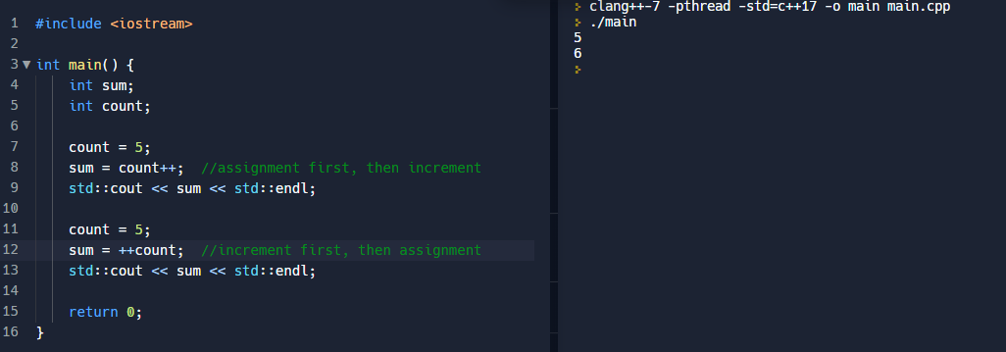
18. What is the difference between sum = count++; and sum = ++count; in C++?
The difference is the order of operations:
sum = count++ will set sum to count, and then increment.
sum = ++count will increment count by 1, and then set sum to count.

Slide 10
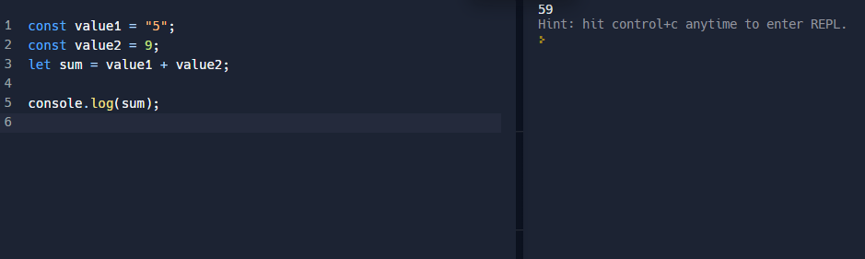
Type Coercion
Type coercion is the automatic conversion of values from one data type into another
Usually done implicitly at run-time
Risk is user not realizing that the coercion happened, possibly leading to errors
JavaScript example

Slide 11
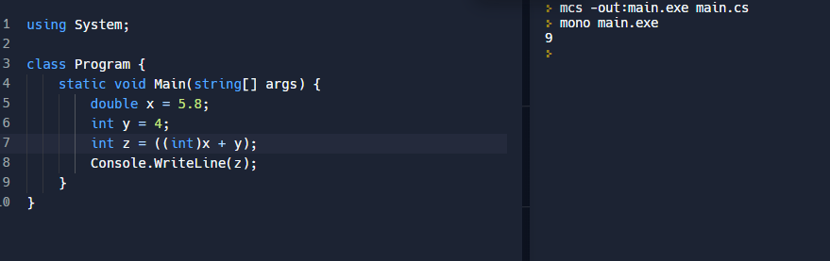
Type Casting?
Similar to type coercion in that it converts data from one type to another, but done explicitly in code
Casting
Conversion happens at compile time
Strongly typed languages such as C# use type casting much more than type coercion
Example in C#, if you don’t cast you will get an error

Slide 12
Difference Between a Narrowing and a Widening Conversion
WIDENING | NARROWING
Conversion from one data type to another data type, where the "destination" data type has a larger range compare to the "source" data type. No data is lost. For example: int to decimal type | A narrowing conversion changes a value to a data type with less precision that might not be able to hold some of the possible values For example: long to int double to float

Slide 13
Strongly Typed Language
To be strongly typed means that the language enforces firm rules around data types and values.
Type errors are detected during compilation
C++ and Java are both strongly typed (nearly)

Slide 14
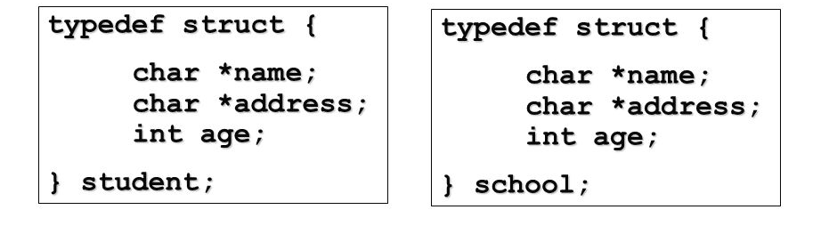
Structure type equivalence
Two types are structurally equivalent if they have the same type structures
Structure-type equivalent

Slide 15
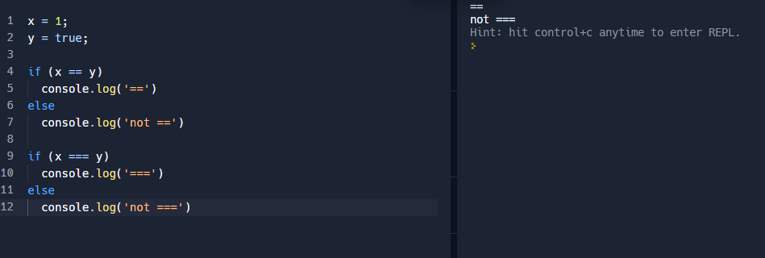
JavaScript, Difference Between == and ===
Both are comparison operators
== compares value
=== compares value and type

Slide 16
Conditional Expression
A conditional expression evaluates a boolean statement, and runs code dependent on if the result of the statement is true or false.
Often times chained together with if statements
x = 1
if (x >=1):
print("Hello :)")
else:
print("Nothing.")

Slide 17
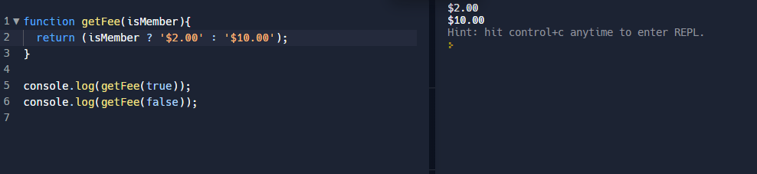
Ternary Operator
A ternary operator is an operator that takes in three operands
A shortcut for an if/else
JavaScript example:

Slide 18
Short Circuit Evaluation
In (expr1 AND expr2)
if expr1 is false, don’t bother evaluating expr2
We know the whole AND statement is false
In (expr1 OR expr2)
if expr1 is true, don’t bother evaluating expr2
We know the whole OR statement is true

Slide 19
Expression versus statements
Most languages distinguish between expressions and statements.
Expressions.
Example: In python, b + c
Statements
Example: in Python, mylist.sort()

Slide 20
Expression Evaluation
Expression-oriented vs. statement-oriented languages
expression-oriented:
functional languages (Lisp, Scheme, ML)
Algol-68
statement-oriented:
most imperative languages
C halfway in-between (distinguishes)

Slide 21
Multiway Assignment
Some languages (including ML, Perl, Python and Ruby) allow multiway assignment.
Example: a,b = c,d;
Defines a tuple; equivalent to a = c; b=d;
Note that this can simplify things:
a,b = b,a; (* no need for an aux variable to swap)
a,b,c = foo(d,e,f);

Slide 22
C and assignments within expressions
Combining expressions with assignments can have unfortunate side effects, depending on the language.
Pathological example: C has no true boolean type (just uses ints or their equivalents), and allows assignments within expressions.
Example:
if (a =b) {
…
}
What does this do?

Slide 23
20. Does the statement: if (x = y) work in C++? In Java? What do you think a PL designer would allow or not allow this?
In C++ this works if the types are compatible
In Java this only works with Booleans
This is called assignment as expression
A PL designer might not allow this because it can lead to errors. The user may be attempting a comparison operation, but is instead performing an assignment.
A PL may allow this for succinctness of code.
Often used with File I/O: while ((ch = getchar()) != EOF)

Slide 24
Side effects and functions
Side Effects
often discussed in the context of functions
a side effect is some permanent state change caused by execution of function
This is when a function modifies a variable that may be used in other functions
Example: x is a global variable and x is modified by a function
some noticable effect of call other than return value
in a more general sense, assignment statements provide the ultimate example of side effects
they change the value of a variable

Slide 25
Question
Consider a function that
Take a parameter, and changes the value of the parameter to 20
Then returns 10
Consider the statements:
a = 10;
b = a + fun(a);
Explain how the order of evaluation could give two different results for b.
Case 1: b = 20, (10 + 10) //a is done before fun(a)
Case 2: b = 30, (20 + 10) //fun(a) is done before a

Slide 26
Expression Evaluation
Side effects are a fundamental aspect of the whole von Neumann model of computation.
What is the von Neumann architecture?
In (pure) functional, logic, and dataflow languages, there are no such changes
These languages are called SINGLE-ASSIGNMENT languages
They are very, very different.

Slide 27
Code optimization
Most compilers attempt to optimize code:
Example: a = b+c, d = a+e, then d = c + e + b
This can really speed up code:
a = b/c/d then e = f/d/c versus
t = c*d and then a = b/t and e = f/t
Arithmetic overflow can really become a problem here.
Can be dependent on implementation and local setup
Checking provides more work for compiler, so slower
With no checks, these can be hard to find

Slide 28
Sequencing
Sequencing
specifies a linear ordering on statements
one statement follows another
very imperative, Von-Neuman
In assembly, the only way to “jump” around is to use branch statements.
Early programming languages mimicked this, such as Fortran (and even Basic and C); they use ‘goto’ statement for jump.

Slide 29
The end of goto
In 1968, Edsger Dijkstra wrote an article condemning the goto statement.
While hotly debated after this, gotos have essentially disappeared from modern programming language.
This is the advent of “structured programming”, a model which took off in the 1970’s. Emphasizes:
Top down design
Modularization of code
Structured types
Descriptive variables
Iteration

Slide 30
Alternatives to goto
Getting rid of goto was actually fairly easy, since it was usually used in certain ways.
Goto to jump to end of current subroutine: use return instead
Goto to escape from the middle of a loop: use exit or break
Goto to repeat sections of code: loops

Slide 31
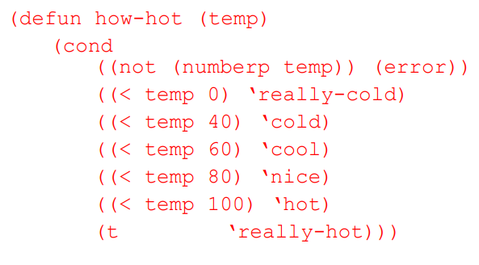
Selection
Selection: introduced in Algol 60
sequential if statements
if ... then ... else
if ... then ... elsif ... else
Lisp variant:
(cond
(C1) (E1)
(C2) (E2)
...
(Cn) (En) (T) (Et)
)

Slide 32
Selection: Case/switch
The case/switch statement was introduced in Algol W to simplify certain if-else situations.
Useful when comparing the same integer to a large variety of possibilities:
i := (complex expression)
if i == 1: …
elsif i in 2,7: …
Case (complex expression)
1: …
2-7: …

Slide 33
Selection: Case/switch
While it looks nicer, principle reason is code optimization.
Instead of complex branching, just loads possible destinations into simple array.
Additional implementations:
If set of labels is large and sparse (e.g. 1, 2-7, 8-100, 101, 102-105, …) then can make it more space efficient using hash tables or some other data structure.

Slide 34
Iteration
Ability to perform some set of operations repeatedly.
Loops
Recursion
Can think of iteration as the only way a function won’t run in linear time.
In a real sense, this is the most powerful component of programming.
In general, loops are more common in imperative languages, while recursion is more common in functional languages.

Slide 35
Flexible for-loops in C.
for(int i=0, int j=4; i>j; i++,j- -){
//two iterators in a for loop
}
for (int i=0; i>variable.length(); i++){
//a function call to return an int to tell when to stop the iterator
}
You are familiar with:
for(int i=0; i < 5; i++){
Code here
}

Slide 36
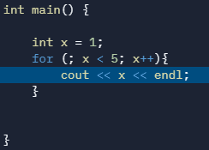
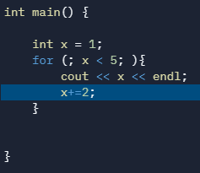
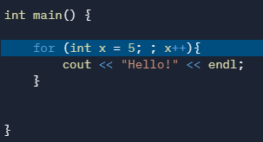
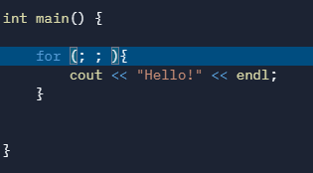
More for loops in C++
Each of the three expressions in a for loop are optional
An absent 2nd expression is considered true

Slide 37
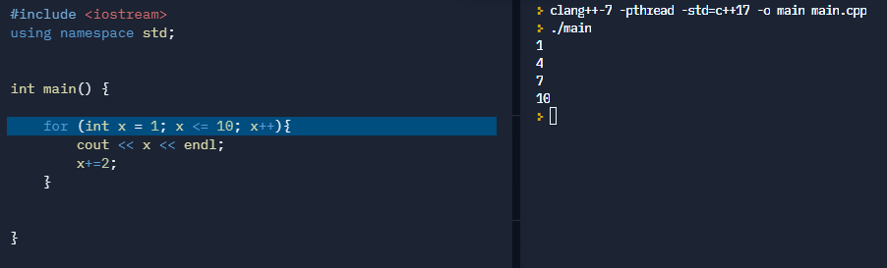
More for loops..
Variables that appear in the loop expression can be changed in the body of the loop

Slide 38
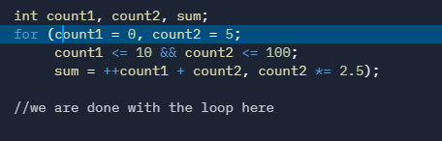
Last one with the for loops…
Loops don’t have to have a body at all

Slide 39
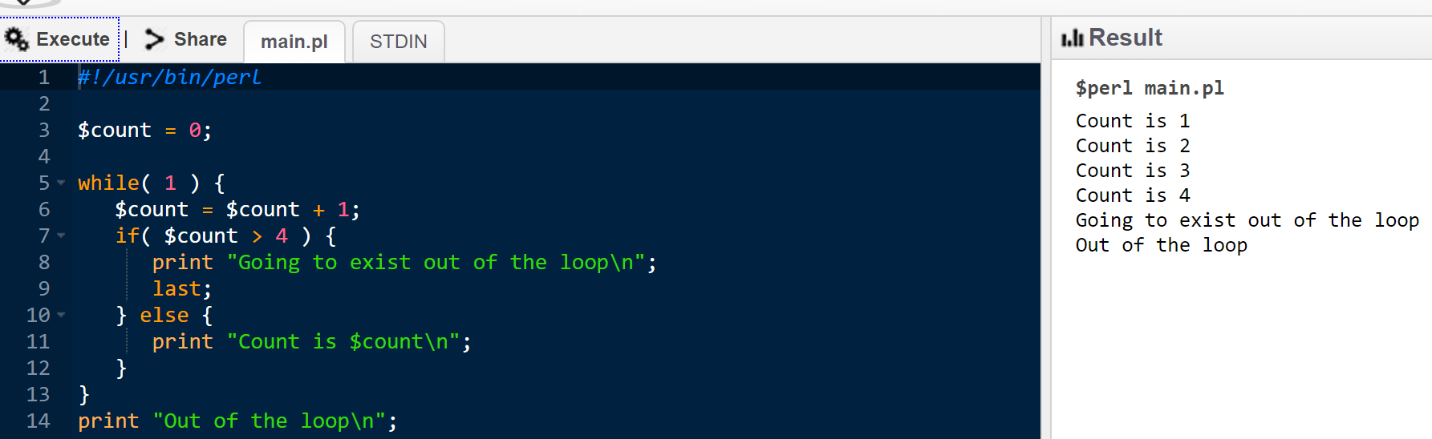
last keyword in a loop in Perl
The last keyword is a loop-control statement that immediately causes the current iteration of a loop to become the last. No further statements are executed, and the loop ends. If LABEL is specified, then it drops out of the loop identified by LABEL instead of the currently enclosing loop.

Slide 40
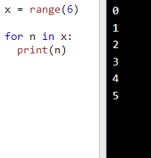
range function in Python
The range() function returns a sequence of numbers, starting from 0 by default, and increments by 1 (by default), and stops before a specified number.

Slide 41
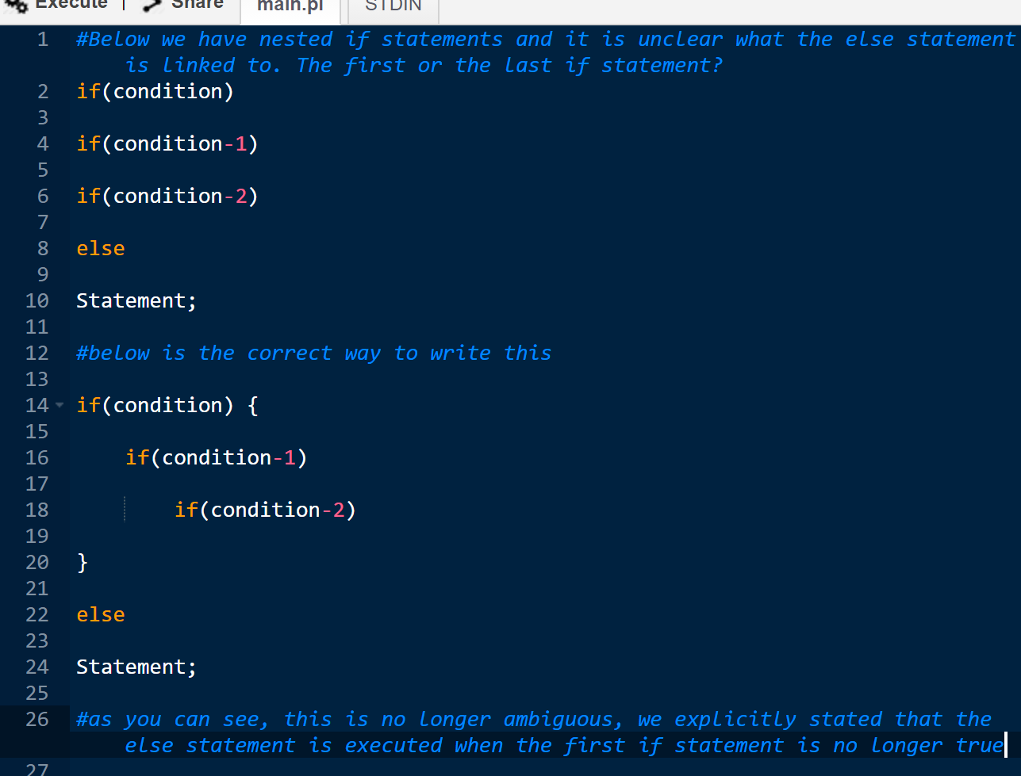
dangling else problem
The dangling else problem happens when there are nested if-statements that are ended by an else statement.
Can be ambiguous.

Slide 42
Recursion
Recursion
equally powerful to iteration
mechanical transformations back and forth
often more intuitive (sometimes less)
naïve implementation less efficient
no special syntax required
fundamental to functional languages like Scheme

Slide 43
Recursion: slower?
Many criticize that recursion is slower and less efficient than iteration, since you have to alter the stack when calling a function.
This is a bit inaccurate. Naively written iteration is probably more effiecient than naively written recursion.
In particular, if the recursion is tail recursion, the execution on the stack for the recursive call will occupy the exact same spot as the previous method.

Slide 44
Recursion
Tail recursion
No computation follows recursive call
int gcd (int a, int b) {
/* assume a, b > 0 */
if (a == b) return a;
else if (a > b) return gcd (a - b,b);
else return gcd (a, b – a);
}
A good compiler will translate this to machine code that runs “in place”, essentially returning to the start of the function with new a,b values.

Slide 45
Recursion: Continuations
Even if not initially tail recursive, simple transformations can often produce tail-recursive code.
Known as continuation-passing. (more in a later chapter)
Additionally, clever tricks - such as computing Fibonacci numbers in an increasing fashion, rather than via two recursive calls - can make recursion comparable.

Slide 46
Order of evaluation
Generally, we assume that arguments are evaluated before passing to a subroutine, in applicative order evaluations.
Not always the case: lazy evaluation or normal order evaluation. pass unevaluated arguments to functions, and value is only computed if and when it is necessary.
Applicative order is preferable for clarity and efficiency, but sometimes normal order can lead to faster code or code that won’t give as many run-time errors.
In particular, for list-type structures in functional languages, this lazy evaluation can be key.

